Slide 1
INVENTORY MANAGEMENT SYSTEM

Slide 2
INTRODUCTION TO INVENTORY MANAGEMENT (Existing System)
Inventory management system objective
Inventory management software is used for a variety of purposes, including:
Maintaining a balance between too much and too little inventory.
Tracking inventory as it is transported between locations.
Receiving items into a warehouse or other location.
Picking, packing and shipping items from a warehouse.
Keeping track of product sales and inventory levels.
Avoiding missing out on sales due to out-of-stock situations.

Slide 3
PROPOSED SYSTEM FUNCTIONALITY
The proposed system has a user friendly Interface for porting of data to server.
The proposed system provides the facility to pull the data from the server of the specified Supply order number and get the respective report.
The proposed system provides the no replication of data.
User can get the desired output according to their queries .This is an added advantage.

Slide 4
METHODODLOGY
Incremental Build Model :
The incremental build model is a method of software development where the product is designed, implemented and tested incrementally (a little more is added each time) until the product is finished. It involves both development and maintenance. The product is defined as finished when it satisfies all of its requirements. This model combines the elements of the waterfall model with the iterative philosophy of prototyping.
The product is decomposed into a number of components, each of which is designed and built separately (termed as builds). Each component is delivered to the client when it is complete. This allows partial utilization of the product and avoids a long development time. It also avoids a large initial capital outlay and subsequent long waiting period. This model of development also helps ease the traumatic effect of introducing a completely new system all at once.

Slide 5
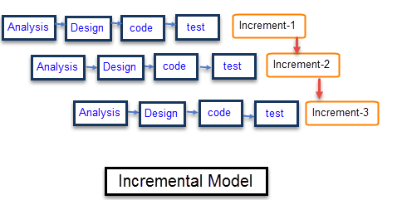
INCREMENTAL MODEL

Slide 6
COMPONENTS OF INVENTORY MANAGEMENT SYSTEM
Client Side Components:
Javascript
HTML
jQuery AJAX
CSS
Server Side Components :
Apache
PHP
MySQL

Slide 7
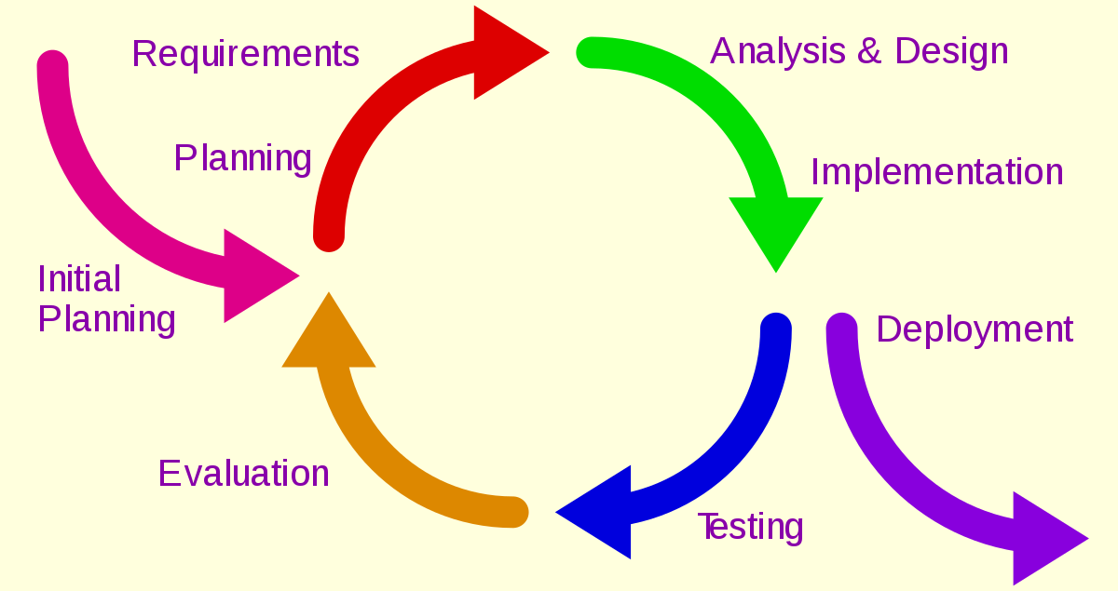
CASUAL LOOP MODEL

Slide 8
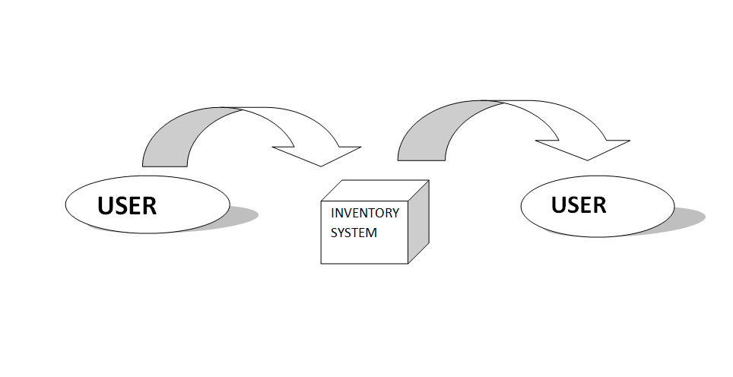
Zero LEVEL DFD

Slide 9
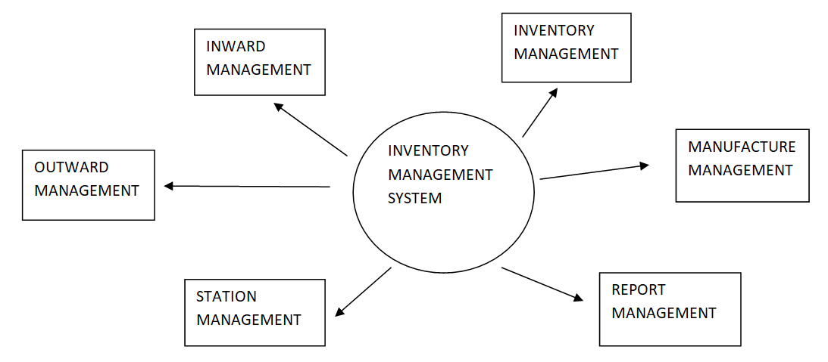
First Level DFD

Slide 10
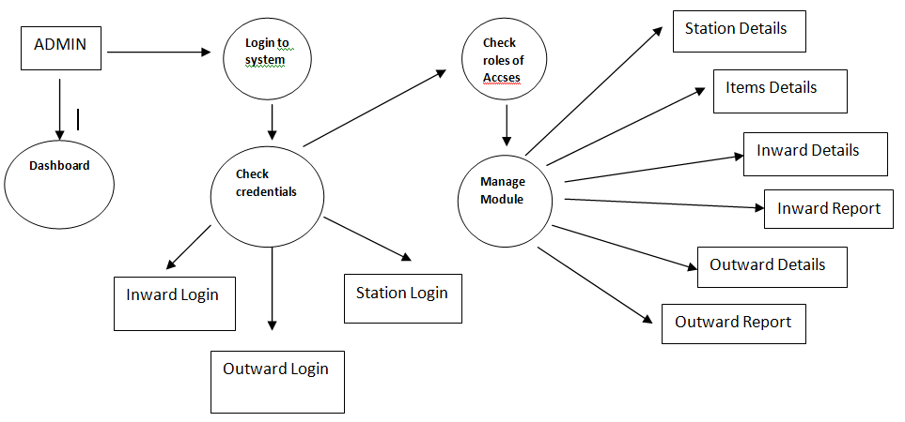
Second Level DFD

Slide 11
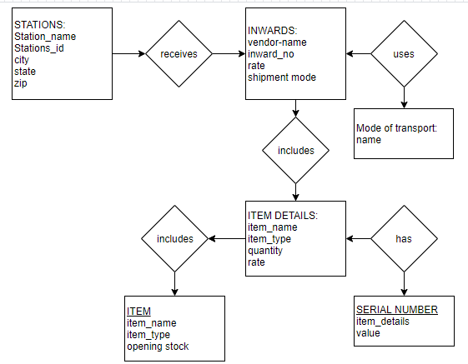
ER DIAGRAM

Slide 12
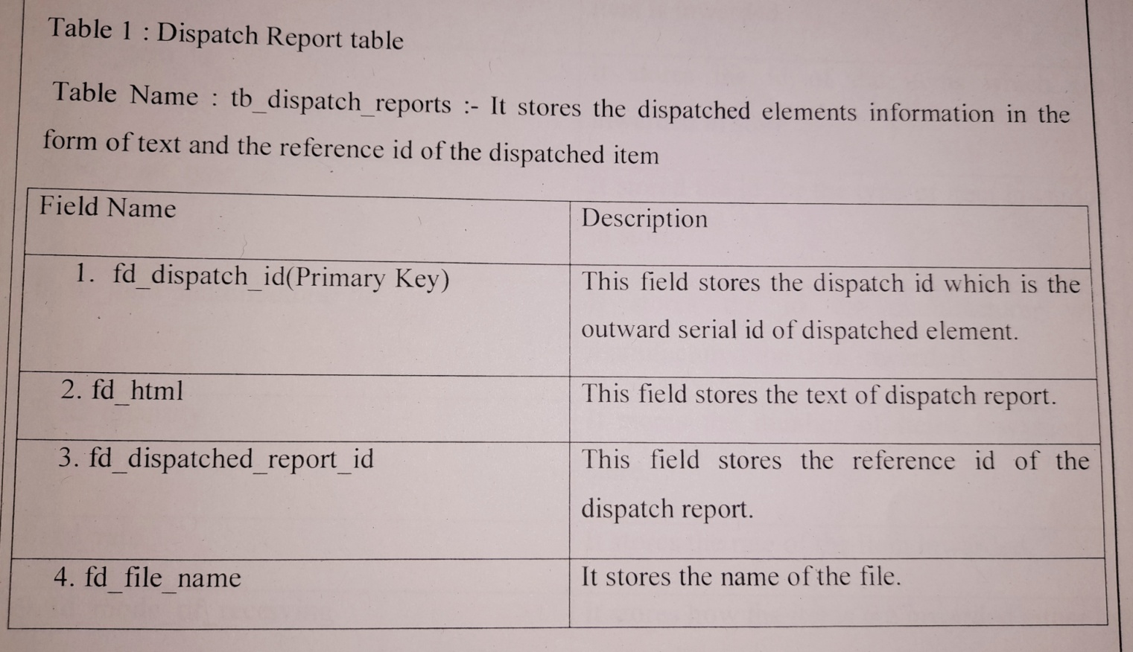
Table Design(Database Table)

Slide 13
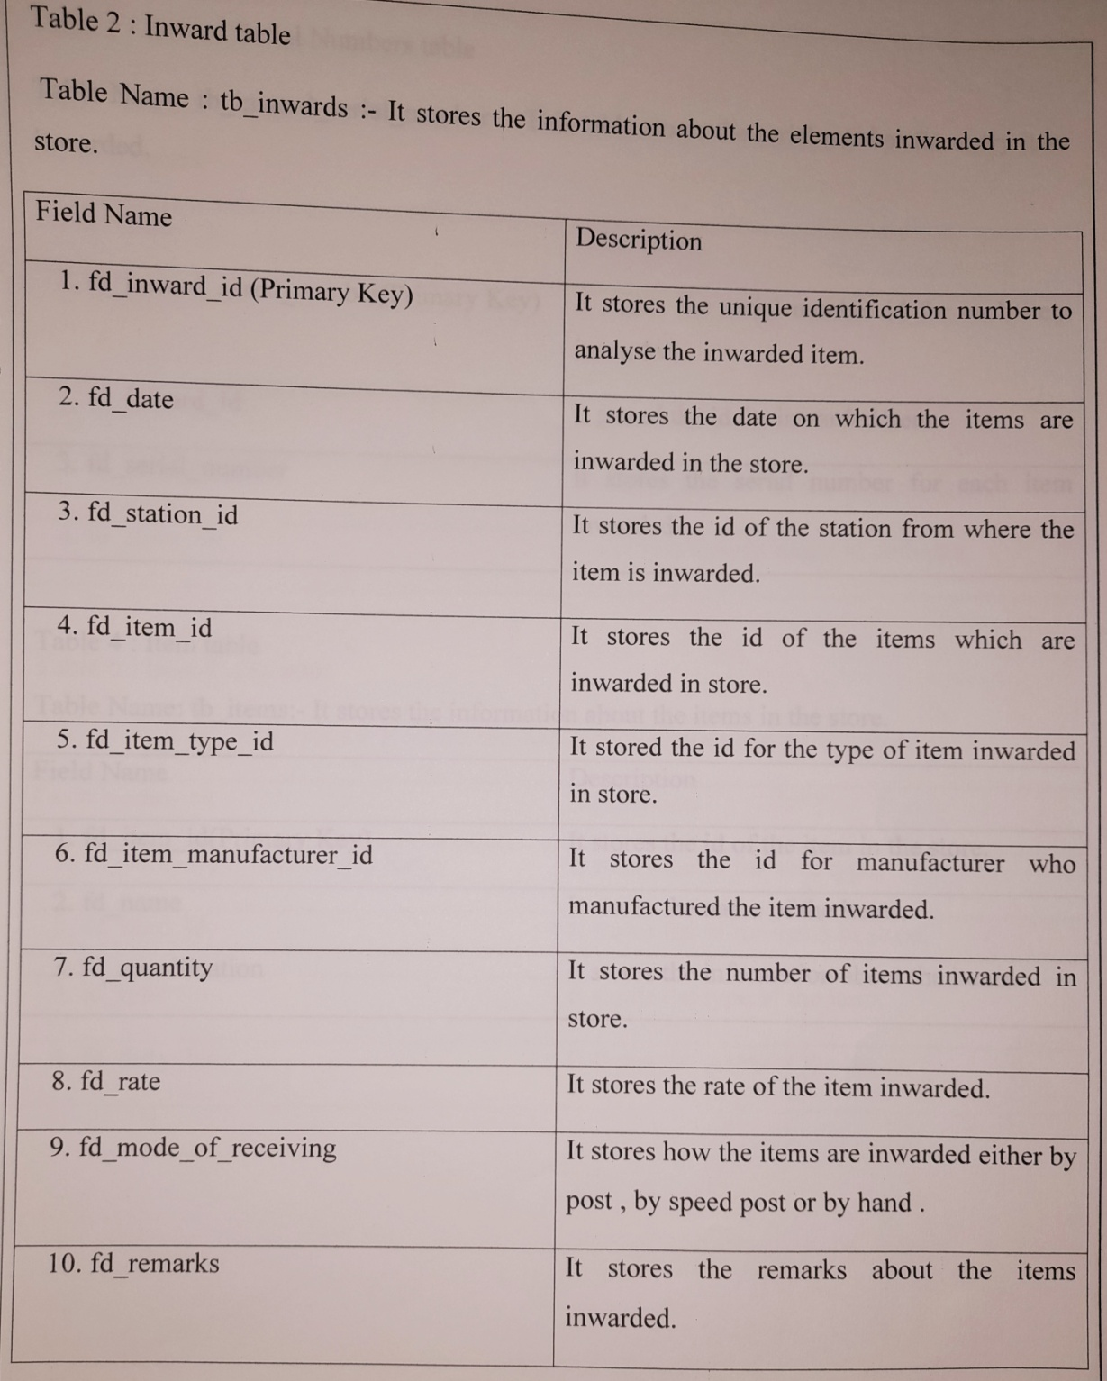
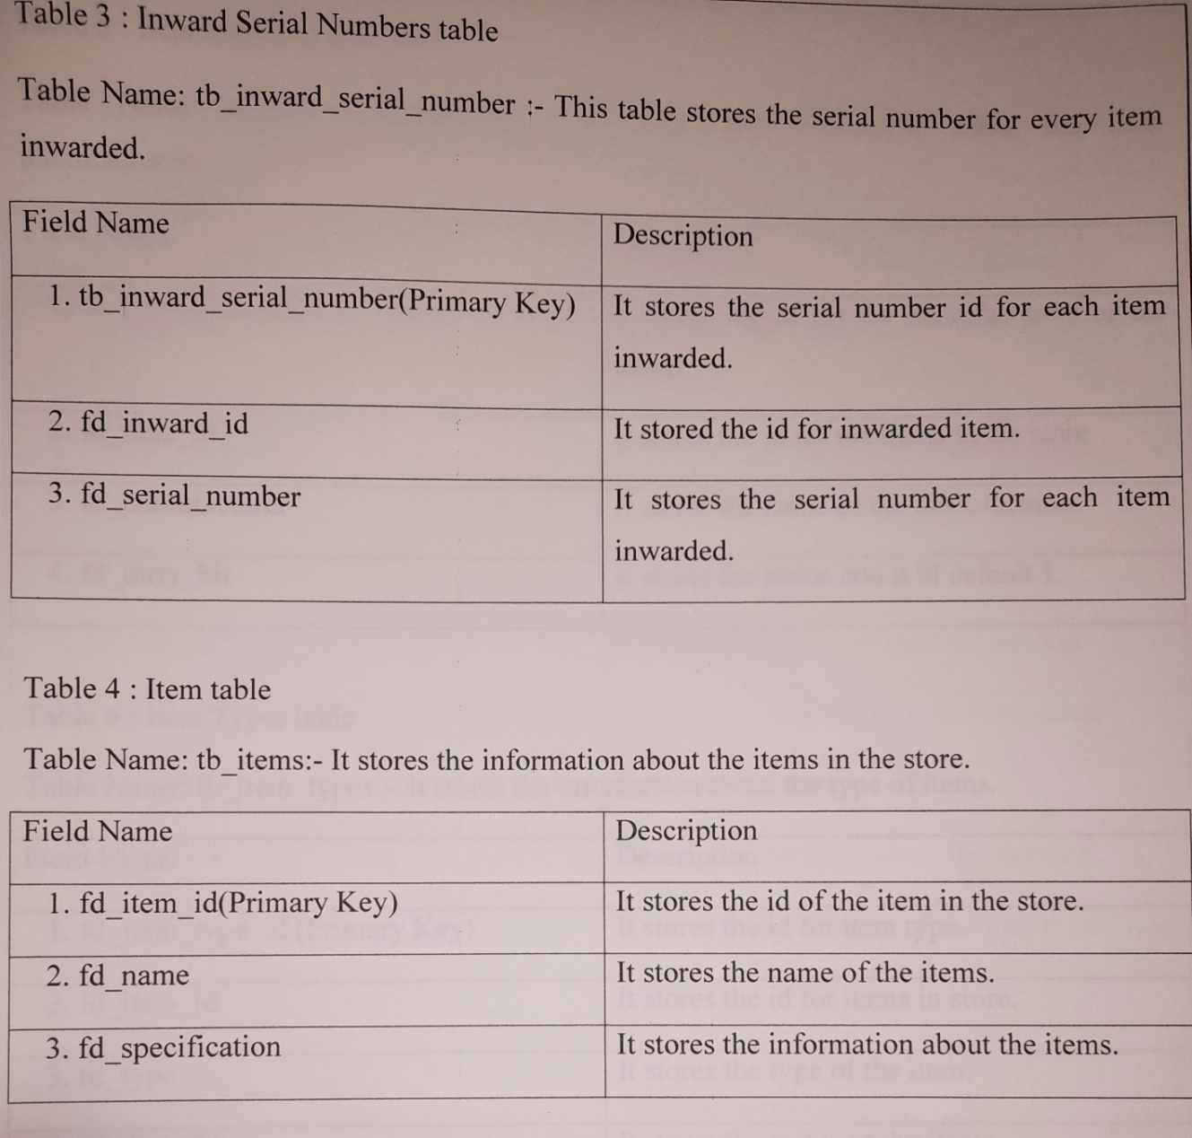

Slide 14
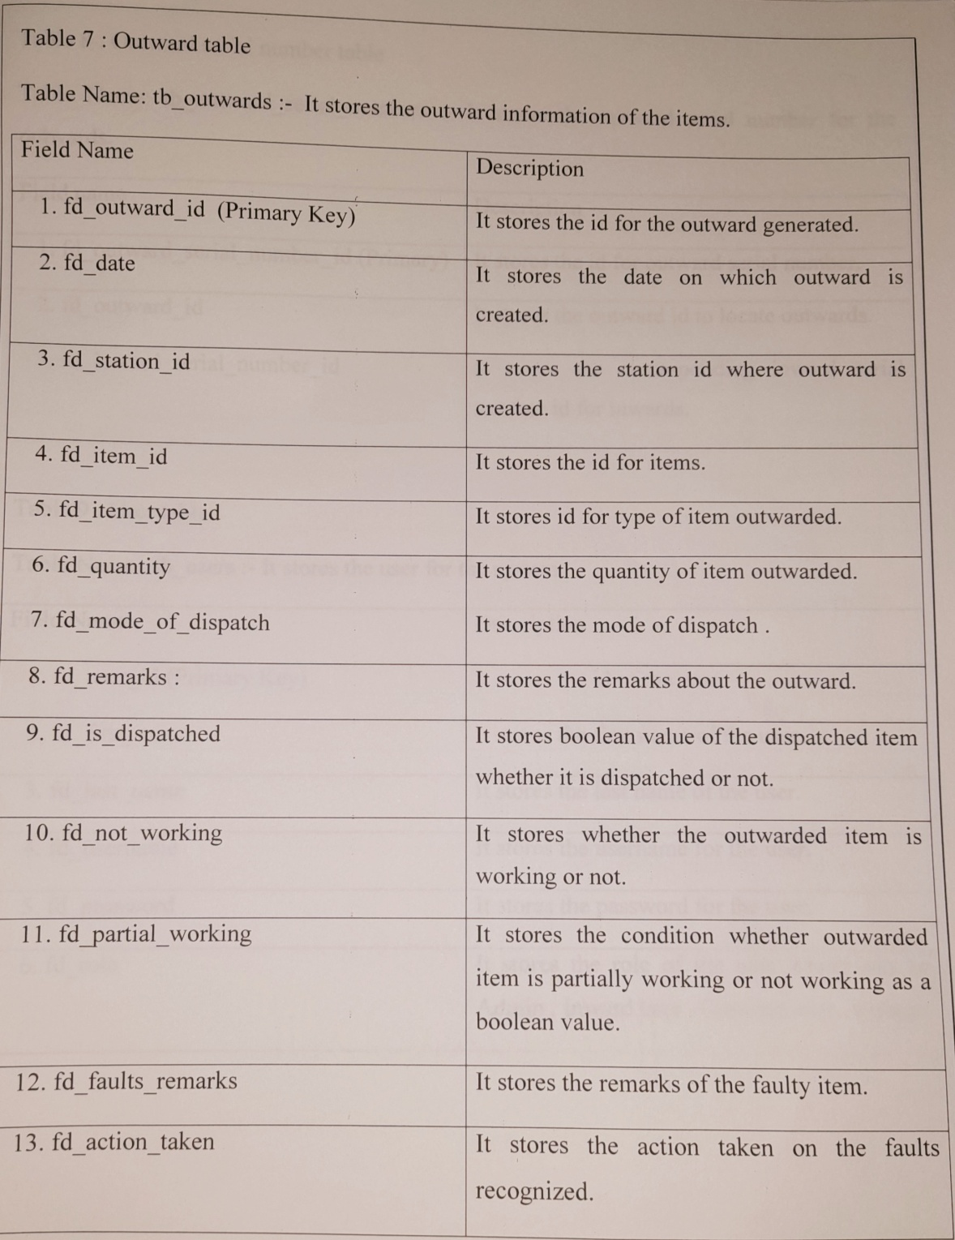
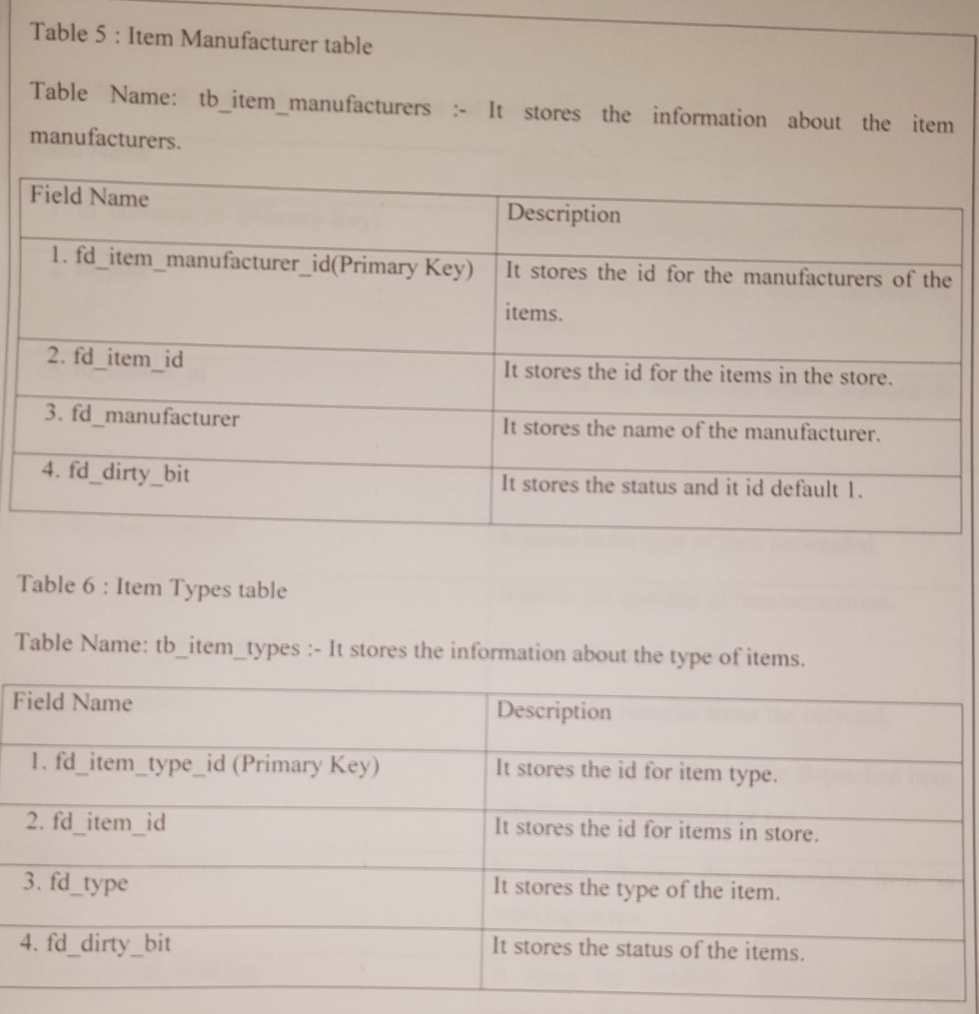

Slide 15
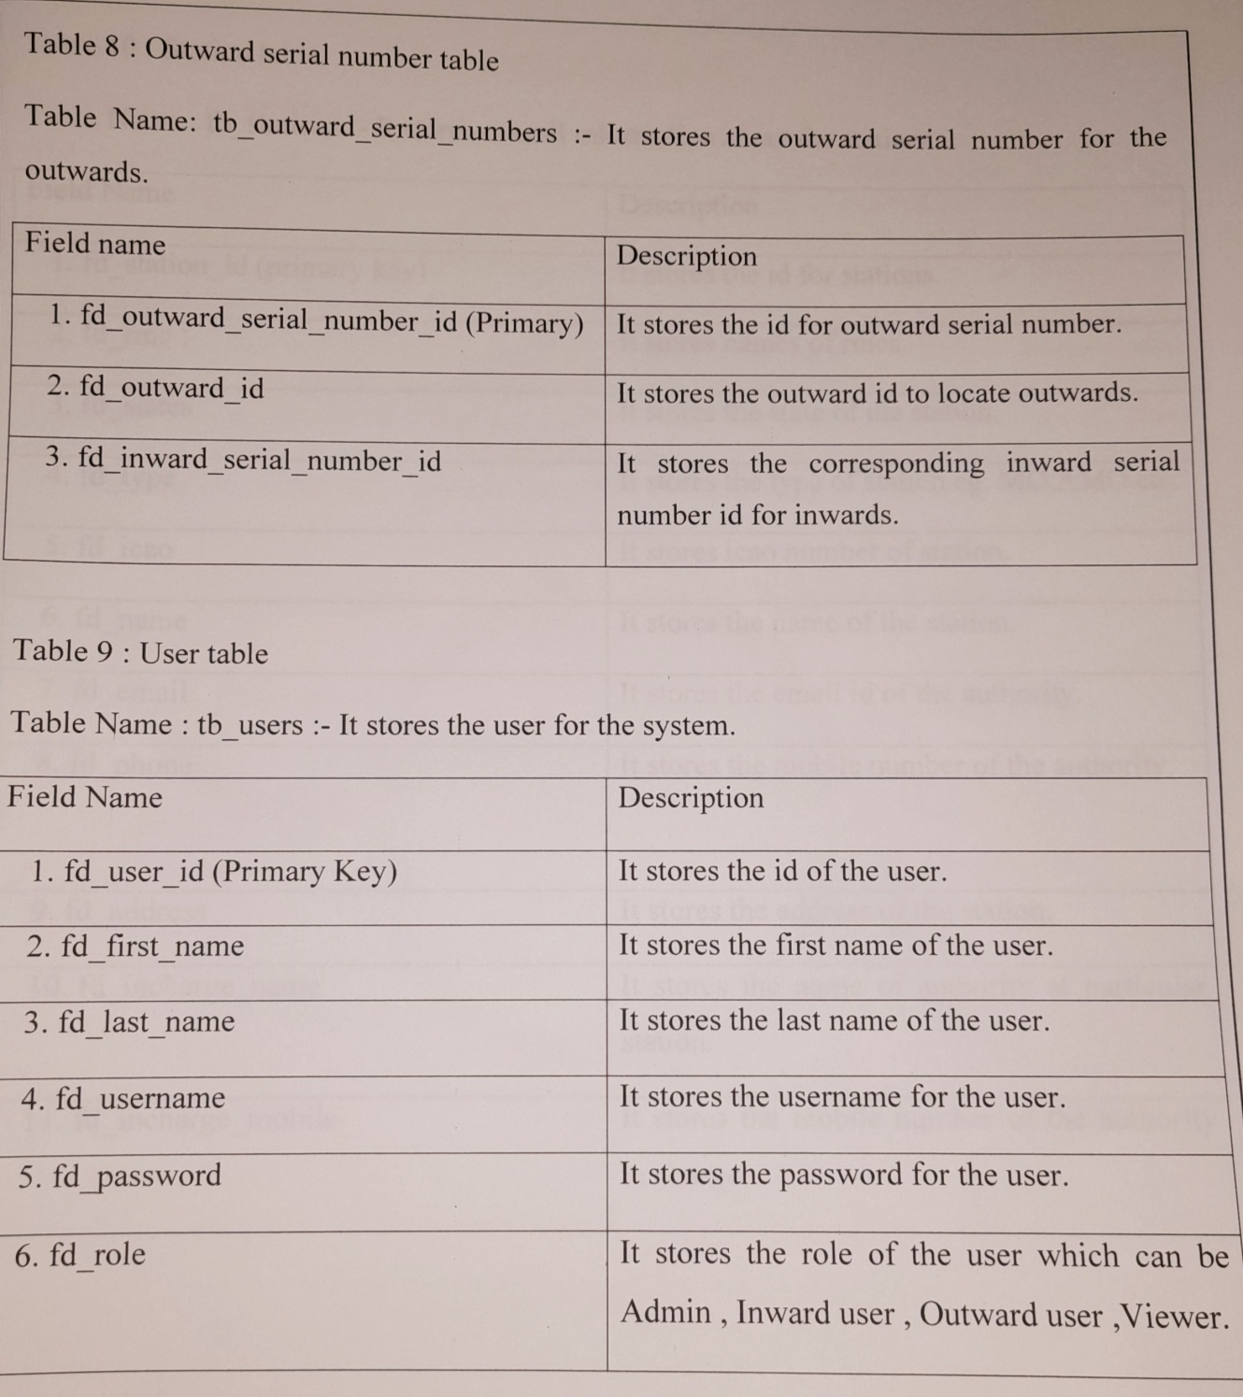
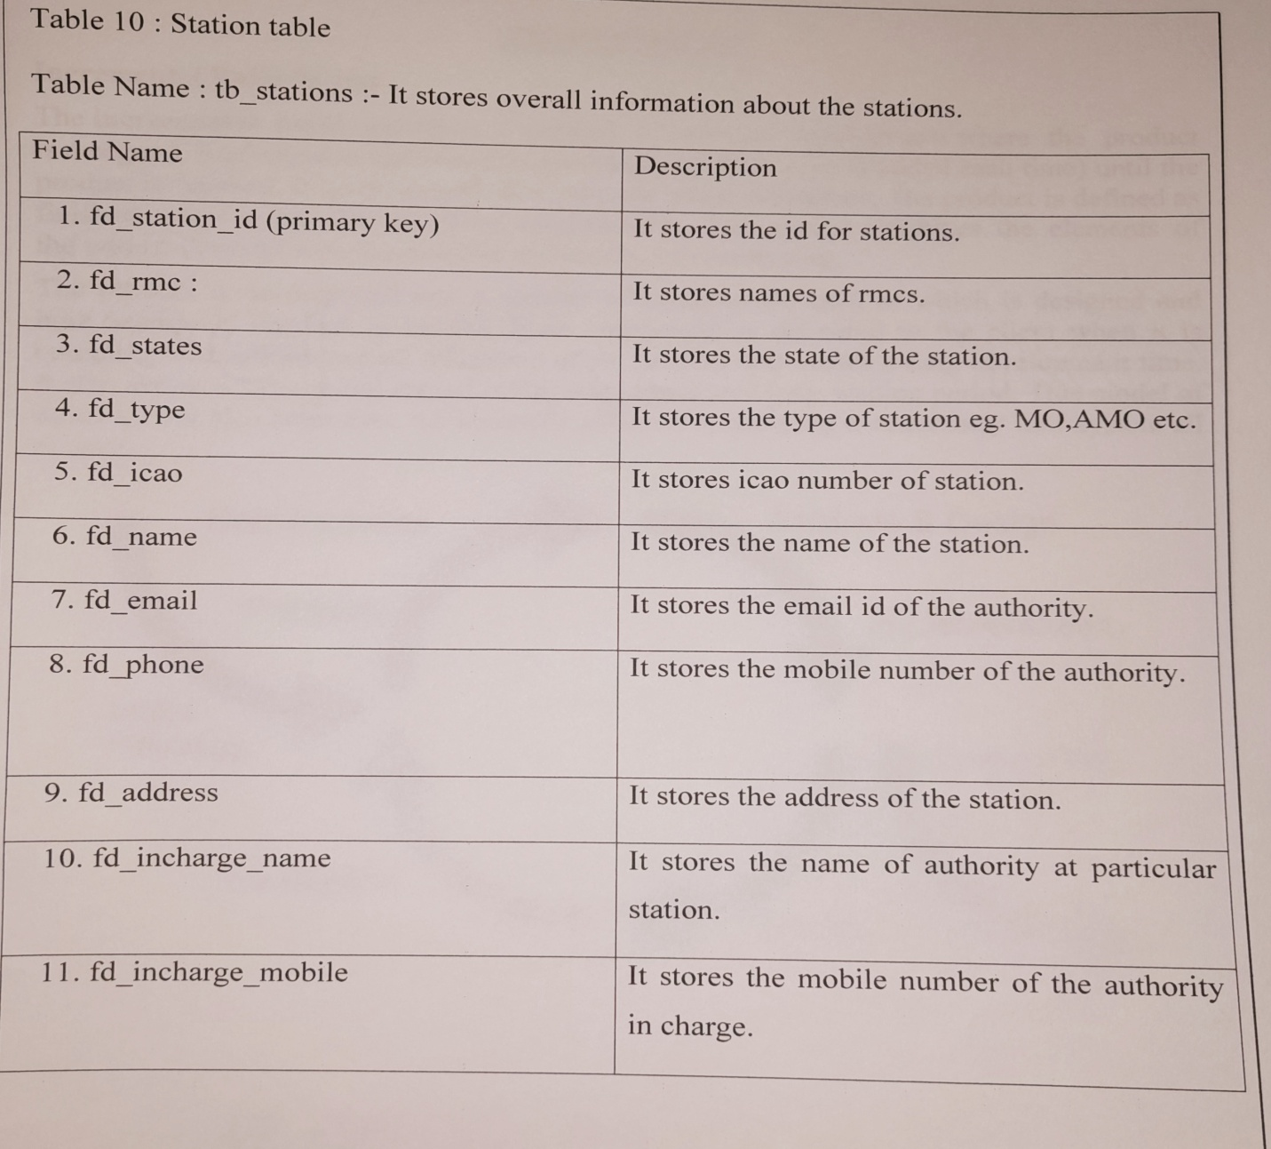

Slide 16
SYSTEM REQUIREMENTS
Software Requirments:
Web server (WAMP)
GitHub
Brackets
Database server (MySQL)
Hardware Requirments:
Processor : i3
RAM : 4 GB
Hard Disk : 20 GB

Slide 17
CONCLUSION
The objective of this project was to build a program for maintaining the details of all Supply Order .
The system developed is able to meet all the basic requirements. It will provide the facility to the user so that they can keep tracks of all the equipments being supplied.
The management of the Inventory will be also benefited by the proposed system, as it will automate the whole supply procedure, which will reduce the workload. The security of the system is also one of the prime concerns.

Slide 18
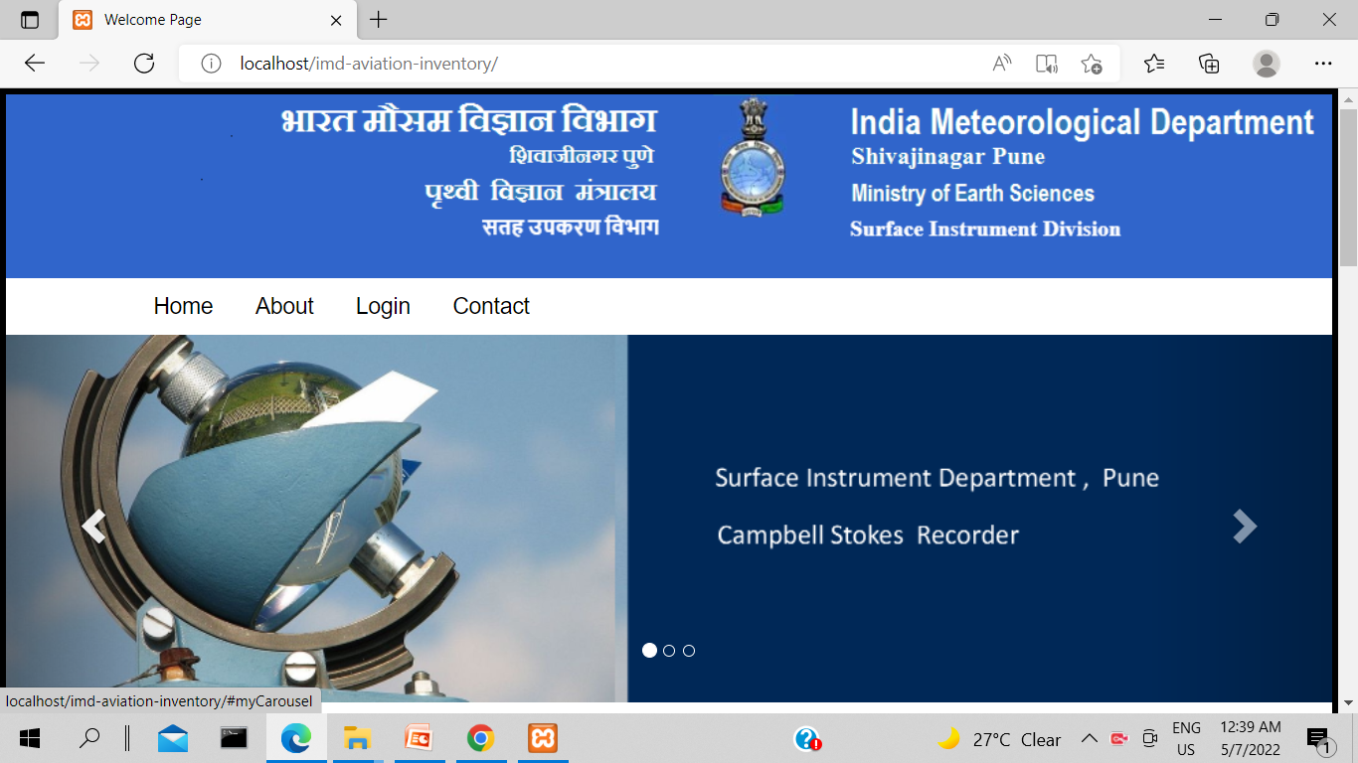
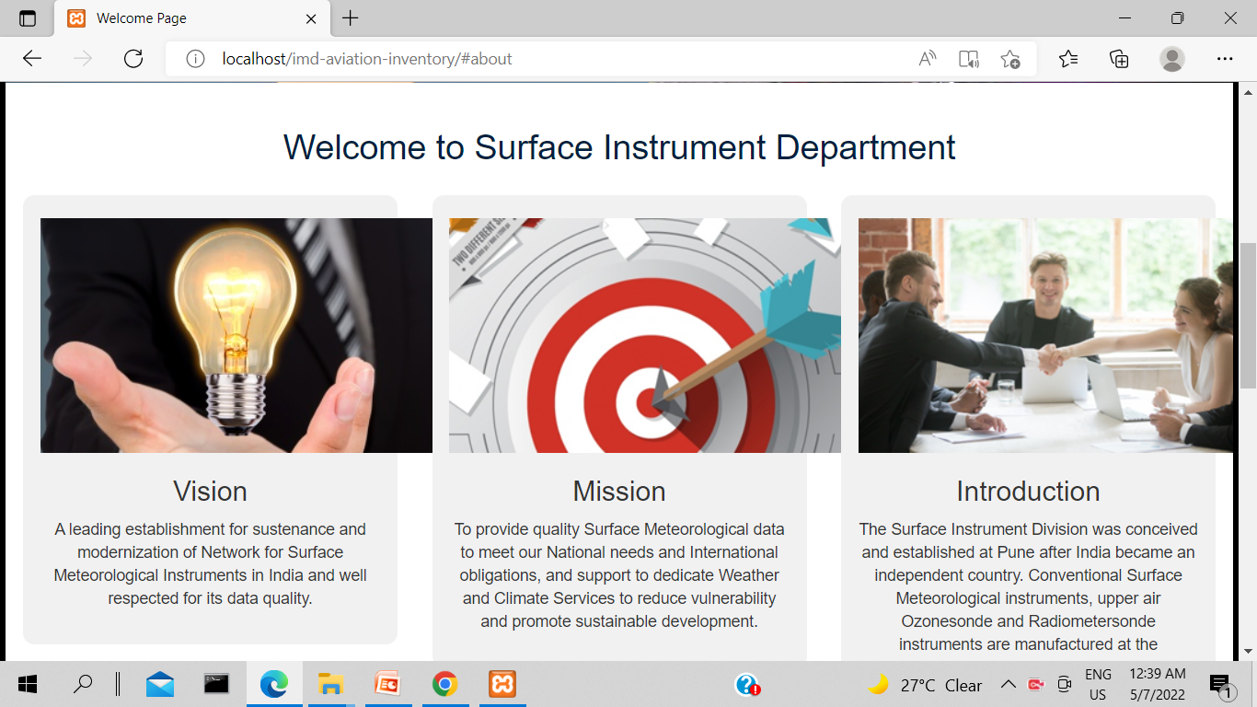

Slide 19
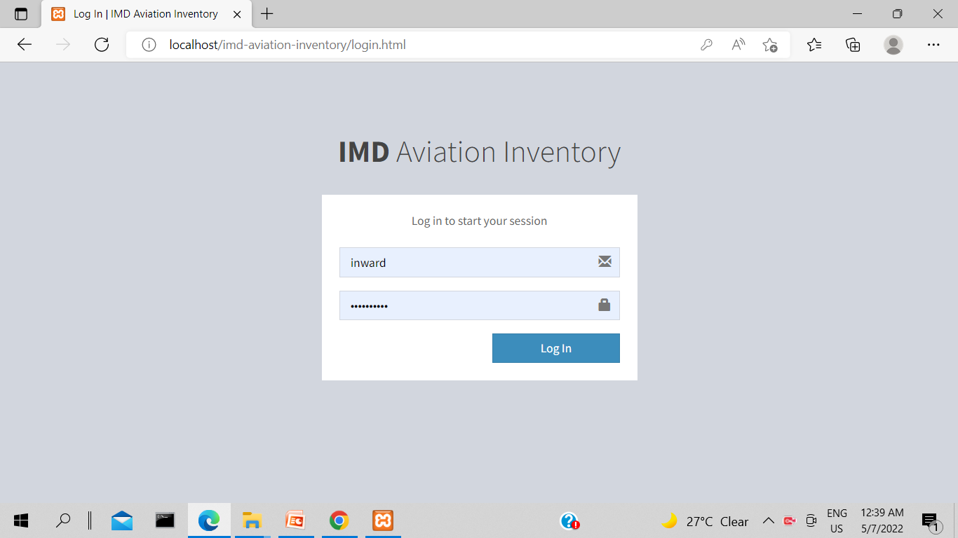
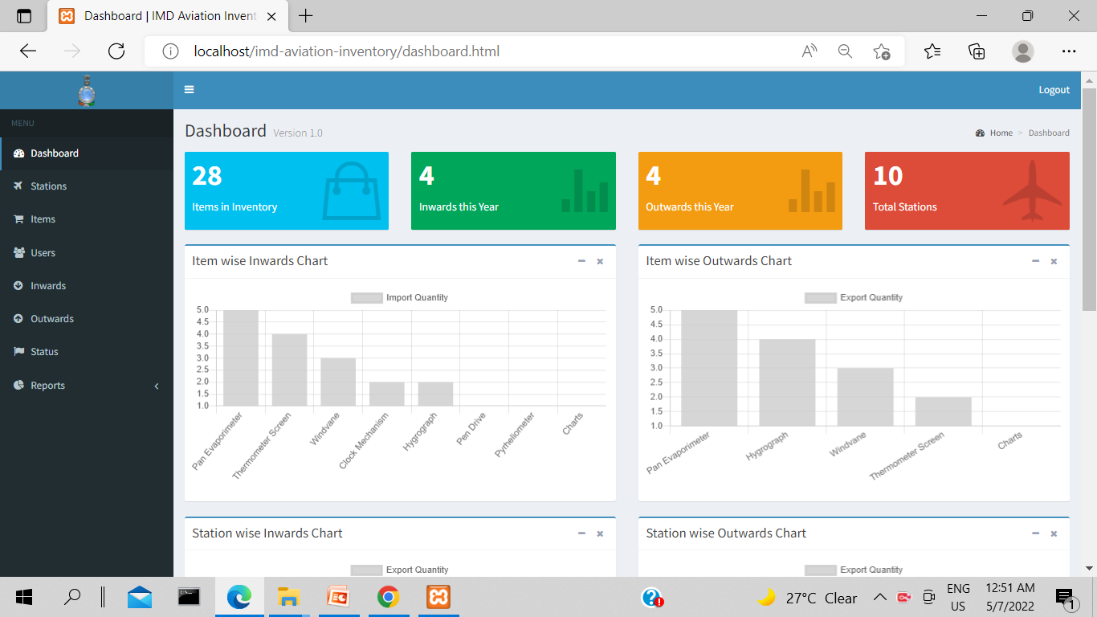

Slide 20
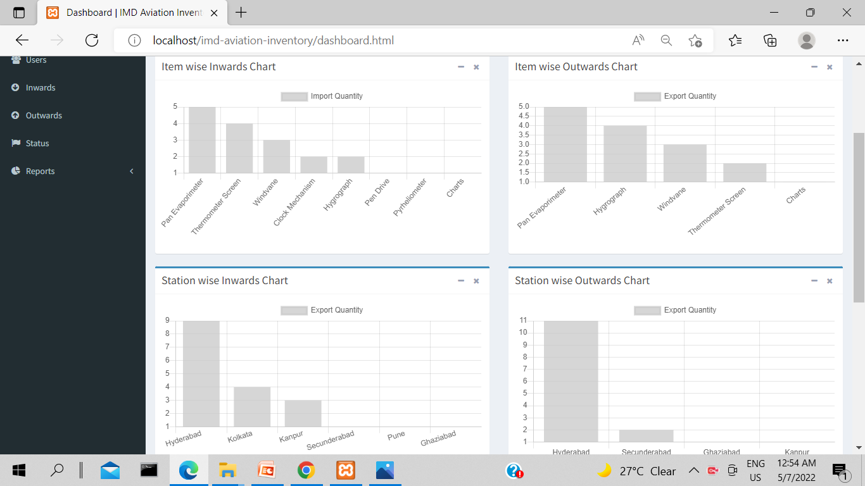
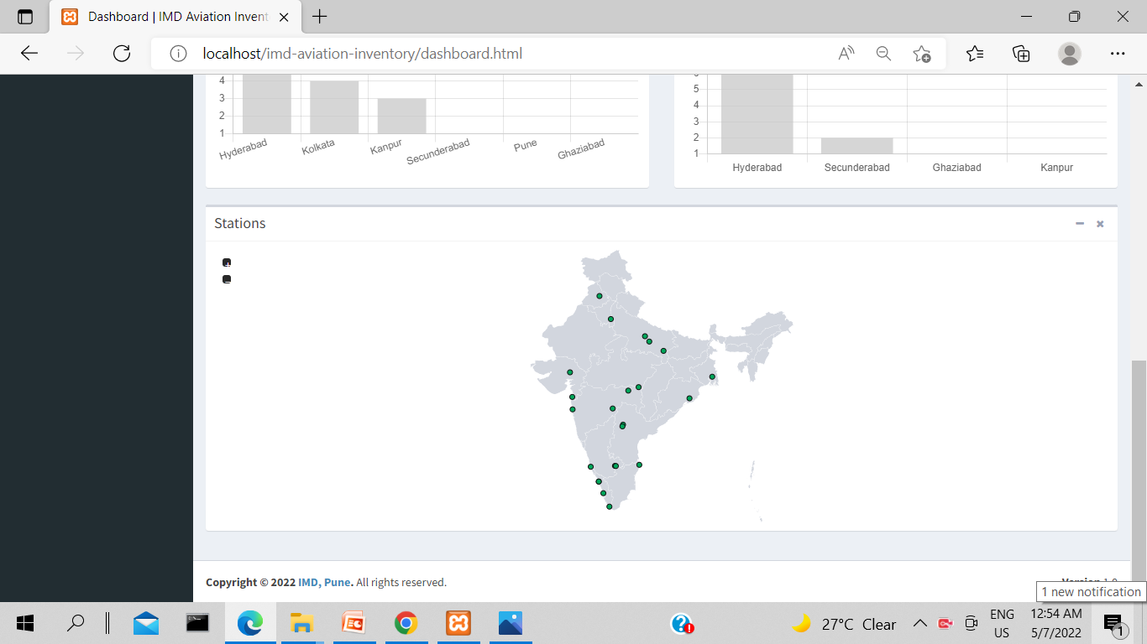

Slide 21
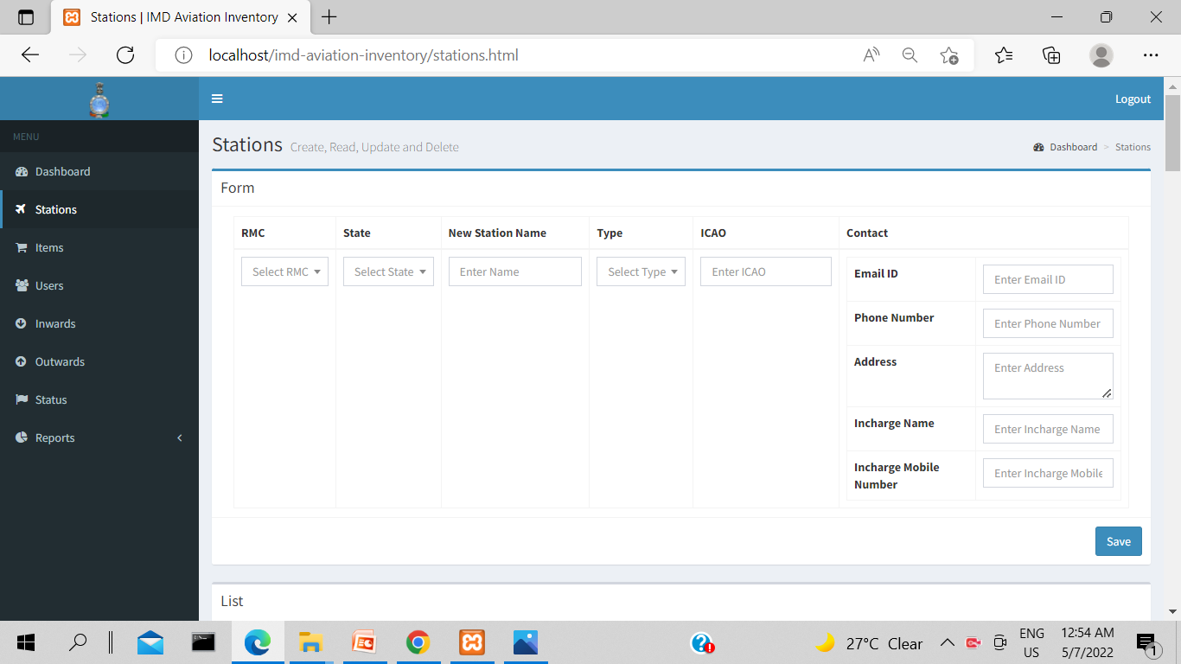
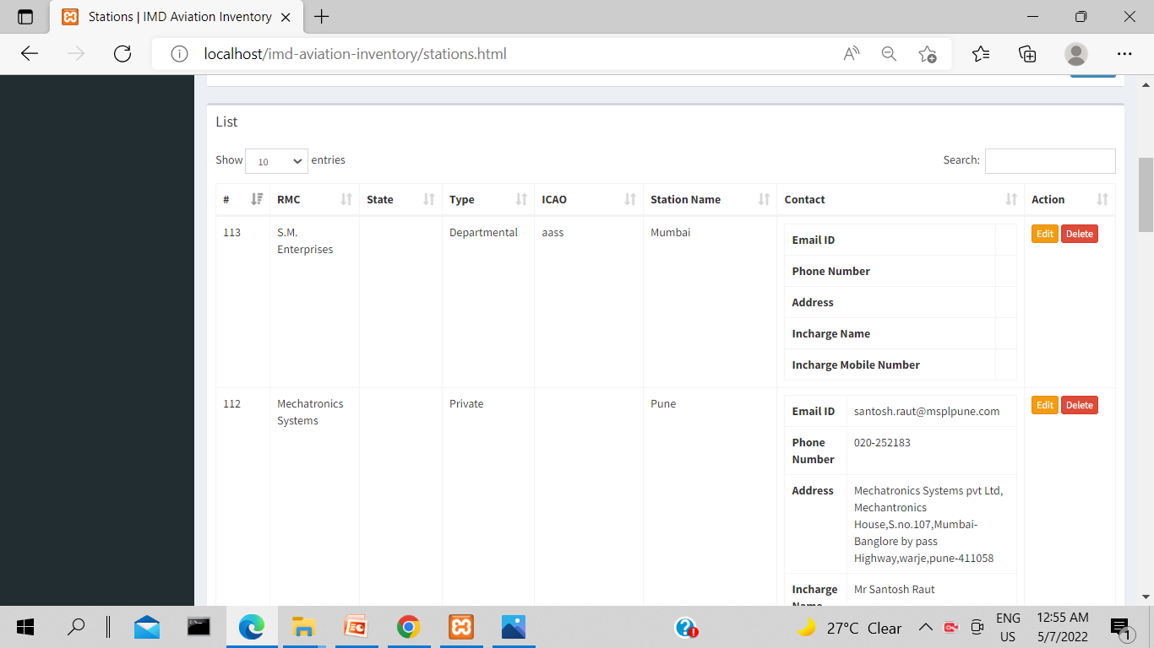

Slide 22
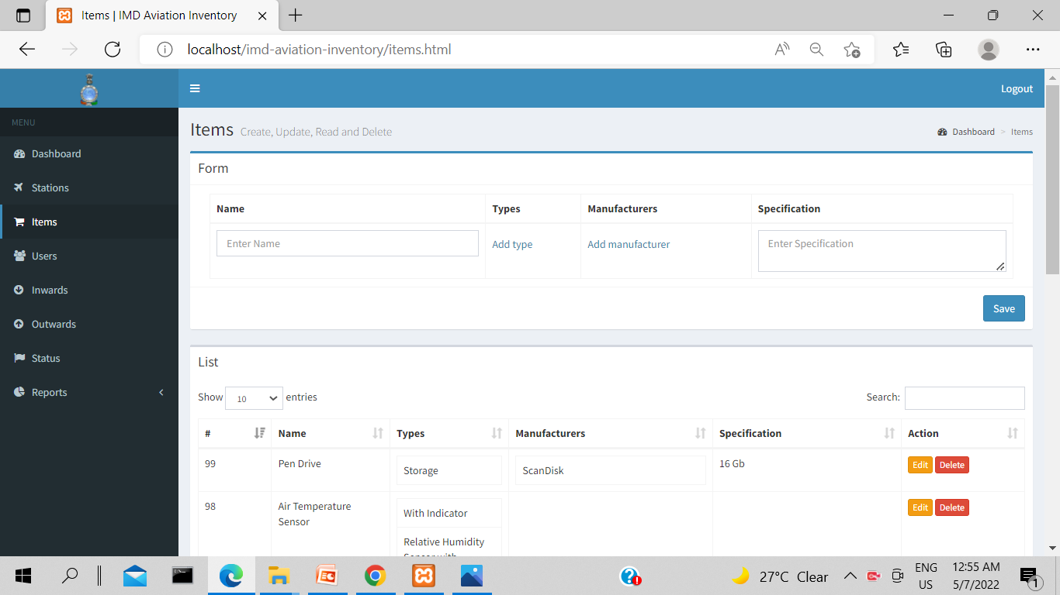
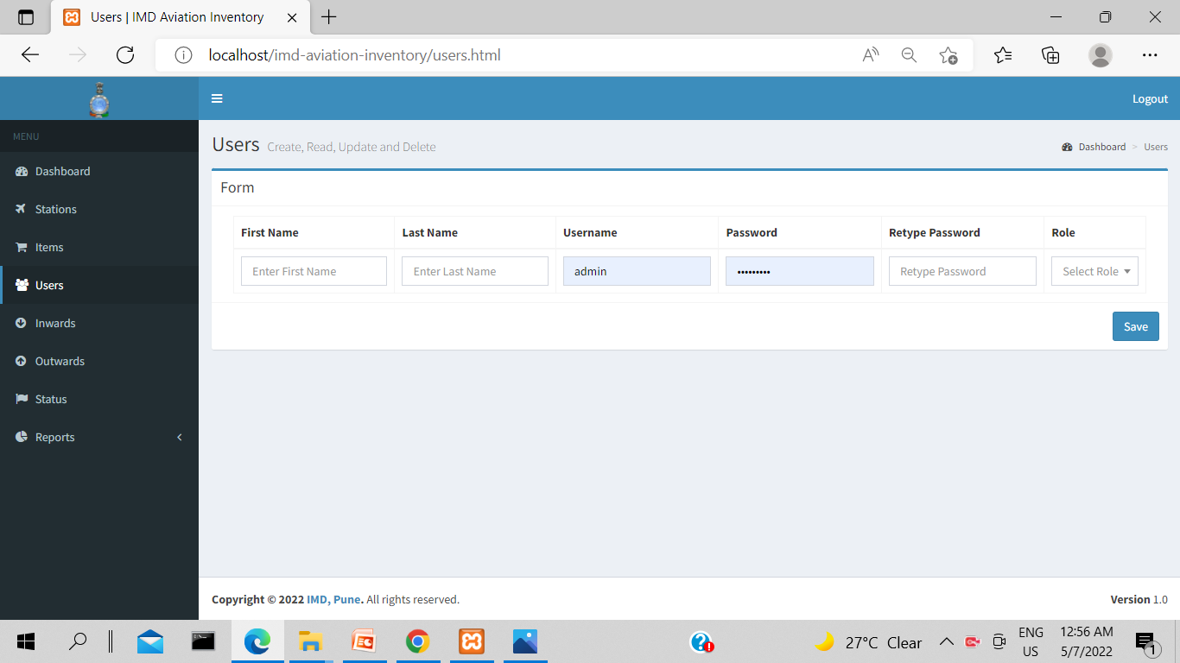

Slide 23
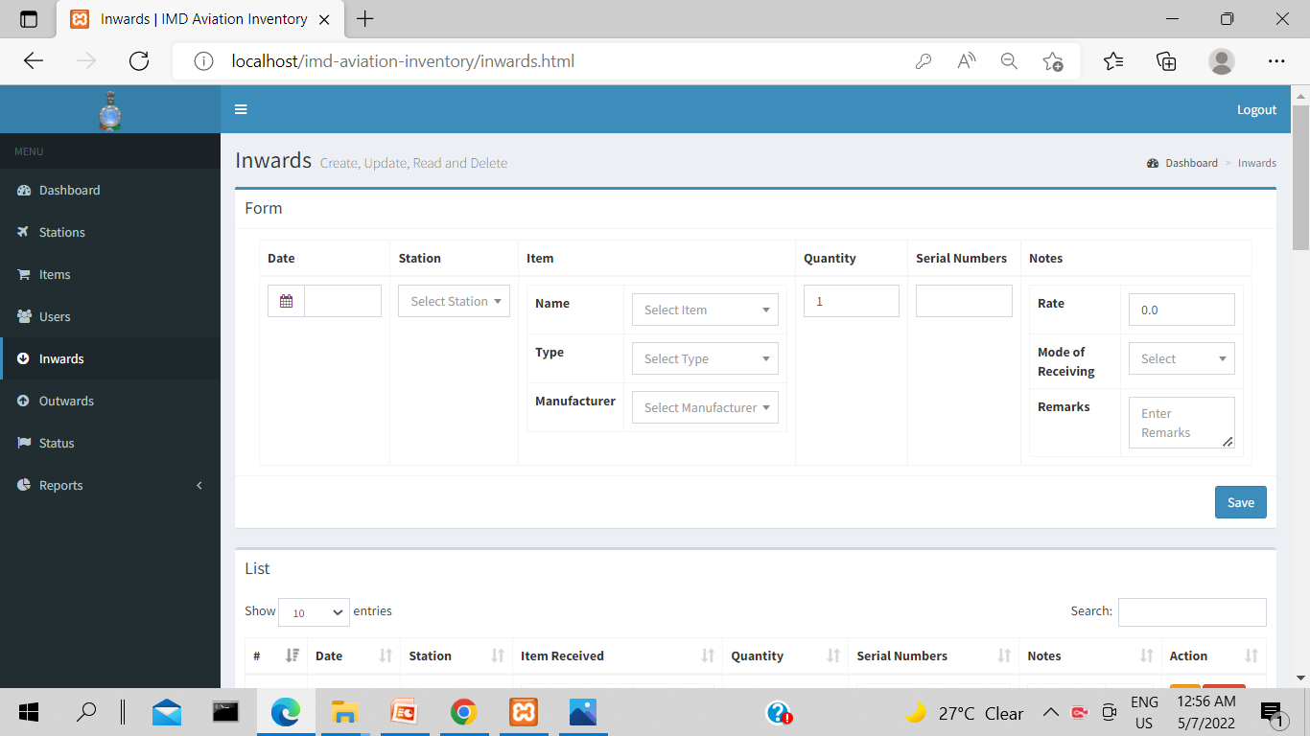
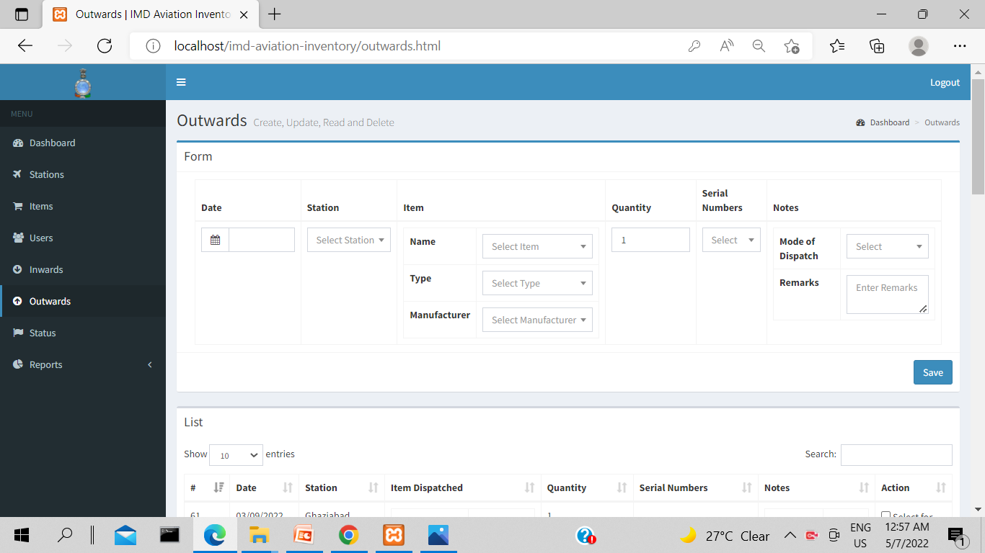

Slide 24
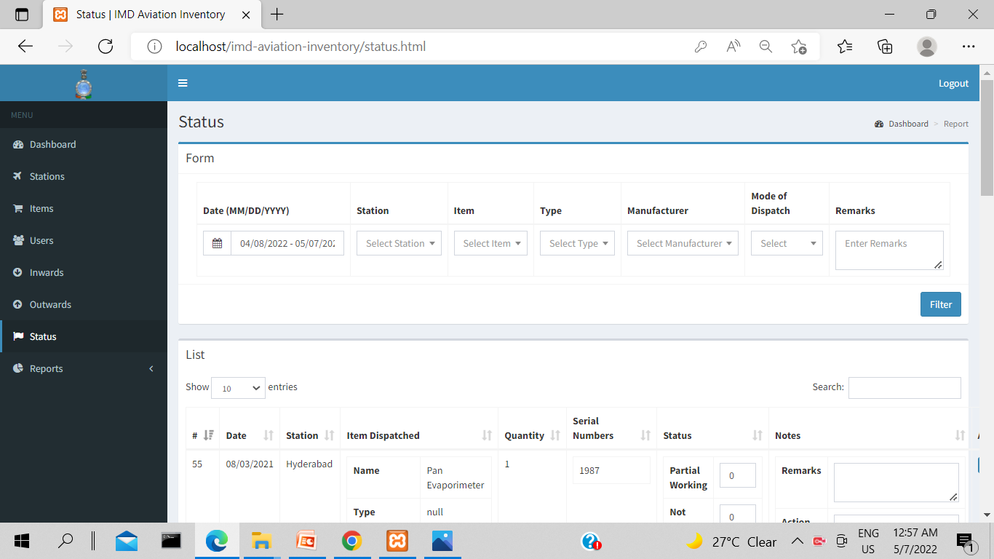
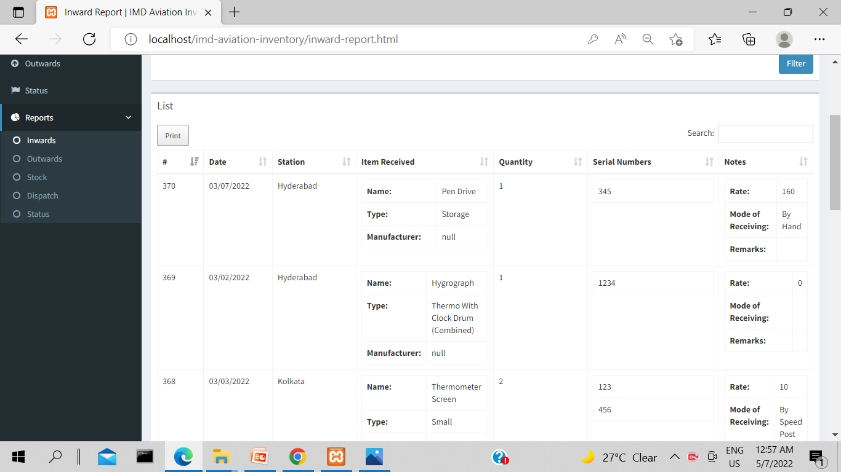

Slide 25
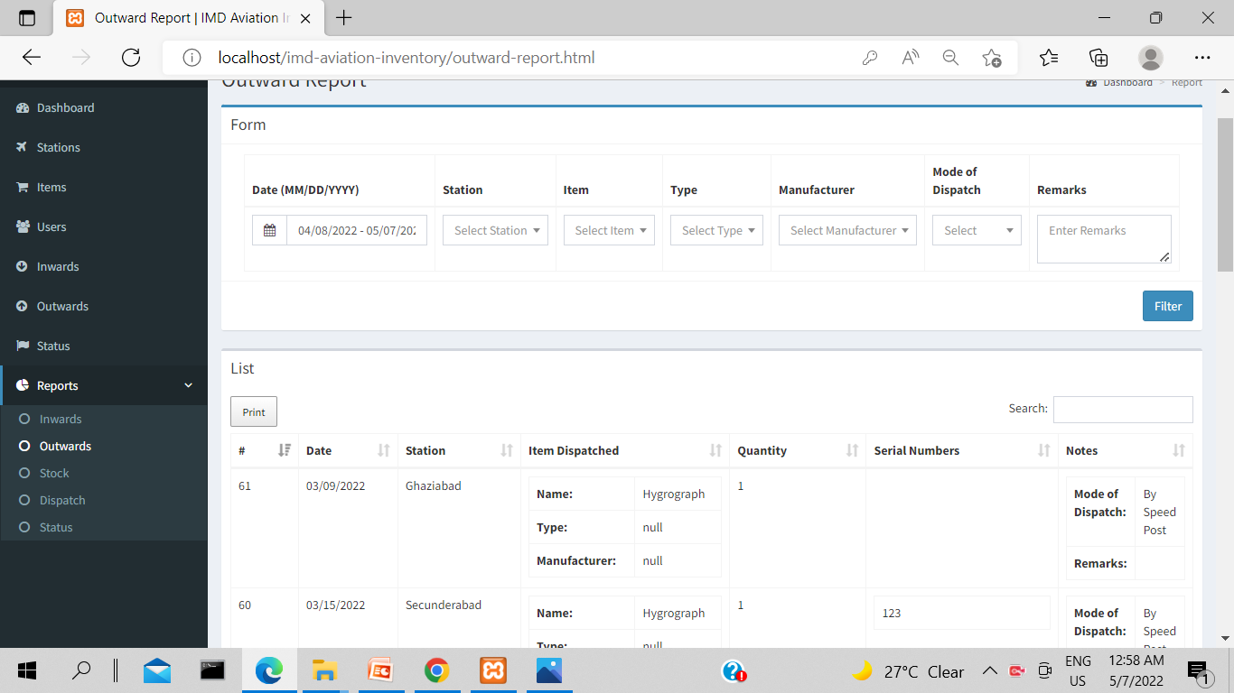
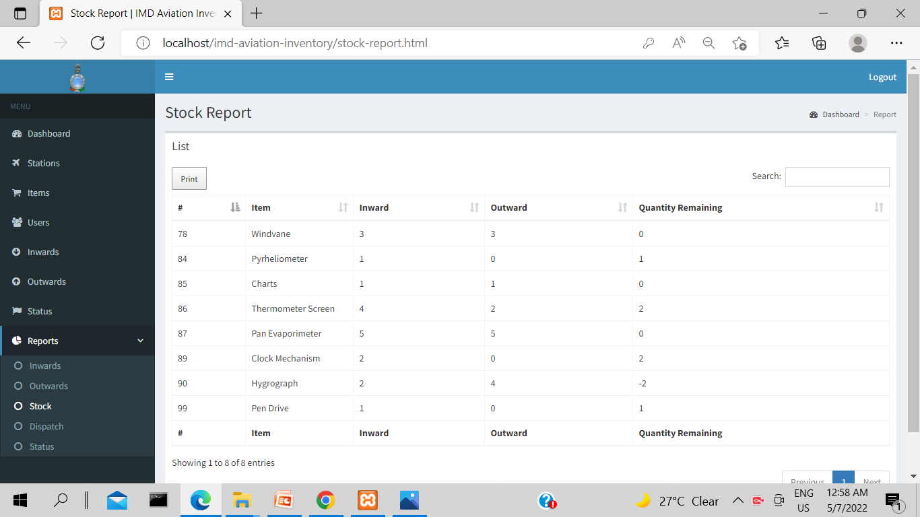

Slide 26
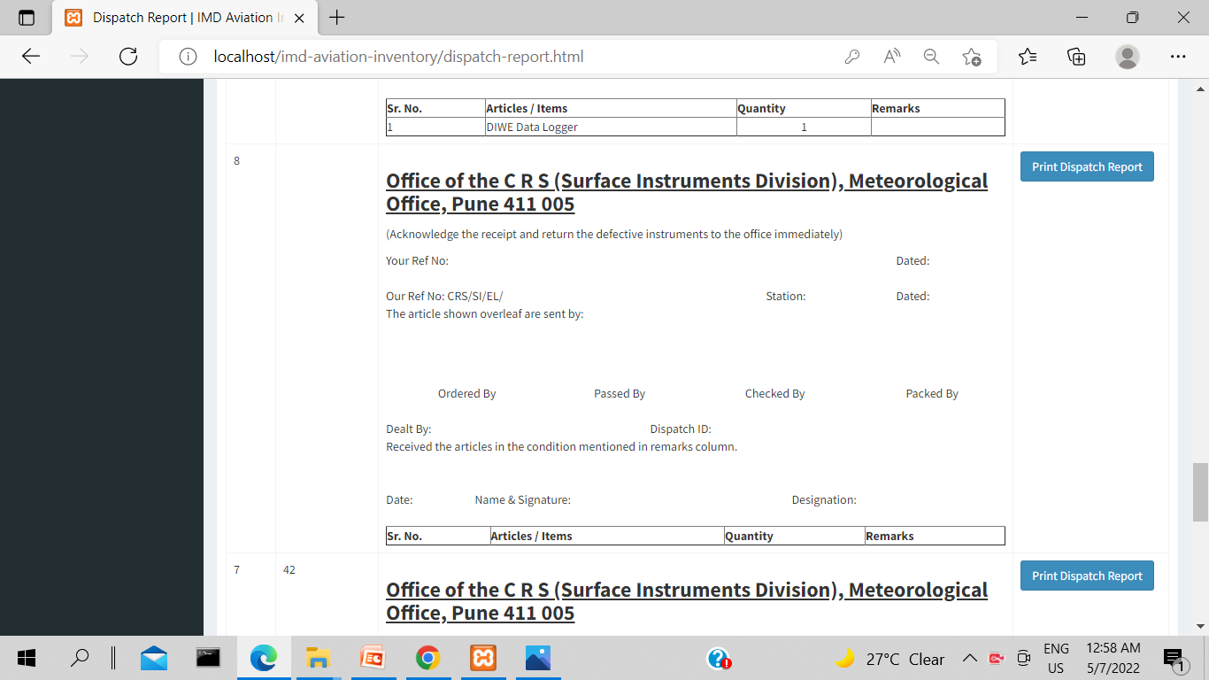


Slide 27
THANK YOU!

